Slide 1

Project Title
Semi-autonomous Wheelchair with Real-Time Object Detection Using YOLOv7
Members’ Name and ID
Md Shahid Mazumder Sagor - 1521883643
Mushtari Mahapara - 1620608042
Faysal Miah - 1721758042
Tanjerul Islam Tanim - 1811942043

Slide 2
Introduction:
This project is intended towards contributing to the helping hand of the paralyzed patients.
This is a multifunctional wheelchair that helps the unable person to control it in ways like- automatic obstacle detection control and remote control.
This project will ensure the security of the disabled person.

Slide 3
Literature Reviews
“ https://ieeexplore.ieee.org/abstract/document/7759691/ ”
“A semi-autonomous framework for human-aware and user intention driven wheelchair mobility assistance”
A semi-autonomous framework for assistive wheelchair navigation in human environments, which is driven by the intention of the wheelchair user. Safe and socially compliant motion provided by a user intention driven local motion planner is fused with user teleoperation in order to create such a system.
“ https://ieeexplore.ieee.org/abstract/document/637806 ”
“The autonomous mobile robot SENARIO: a sensor aided intelligent navigation system for powered wheelchairs”
The SENARIO project is develoing a sensor-aided intelligent navigation system that provides high-level navigational aid to users of powered wheelchairs.

Slide 4
“ https://ieeexplore.ieee.org/abstract/document/1667933 ”
“Semiautonomous Wheelchair Based on Quarry of Environmental Information”
The robot adapts to the environment based on the remote and contact information. In order to adapt to the remote environment, the obstacle avoidance problem is treated. This kind of robot motion control is based on position control.
For The Object Detection
“Real-Time Object Detection Using YOLO: A Review”
“https://www.researchgate.net/publication/351411017_Real-Time_Object_Detection_Using_YOLO_A_Review”
A study has been done in by Upulie Handalage, Lakshini Kuganandamurthy to detect object. They used Convolutional Neural Networks to data pre-processing. Then, they used a YOLO detector for their model.
“CPU Based YOLO: A Real Time Object Detection Algorithm”
“https://ieeexplore.ieee.org/document/9230778”
Another research done by Md. Bahar Ullah to detect object,in this computer vision with Deep Learning has been established and accomplished with time, primarily over one particular well-known algorithm named Convolutional Neural Networks (CNN). To generate a single step procedure including object detection and classification You Only Look Once (YOLO) was introduced.

Slide 5
Proposed solution:
Demo chair
ANDROID CONTROL ROBOT CAR
Obstacle detection sensor

Slide 6
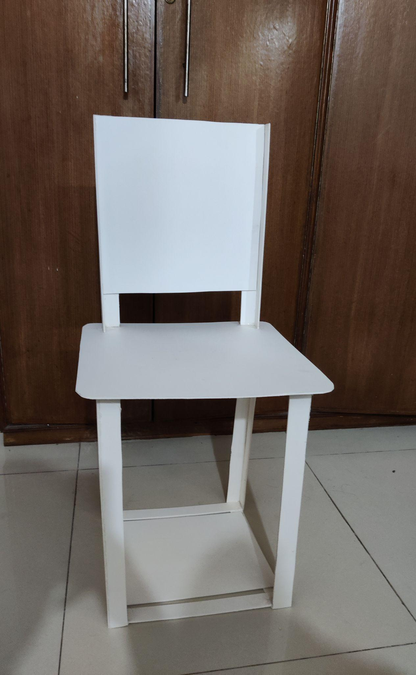
Demo Chair
We make a demo chair by using light weight PVC board.
This demo chair will work as a wheelchair while demonstrating the project.

Slide 7
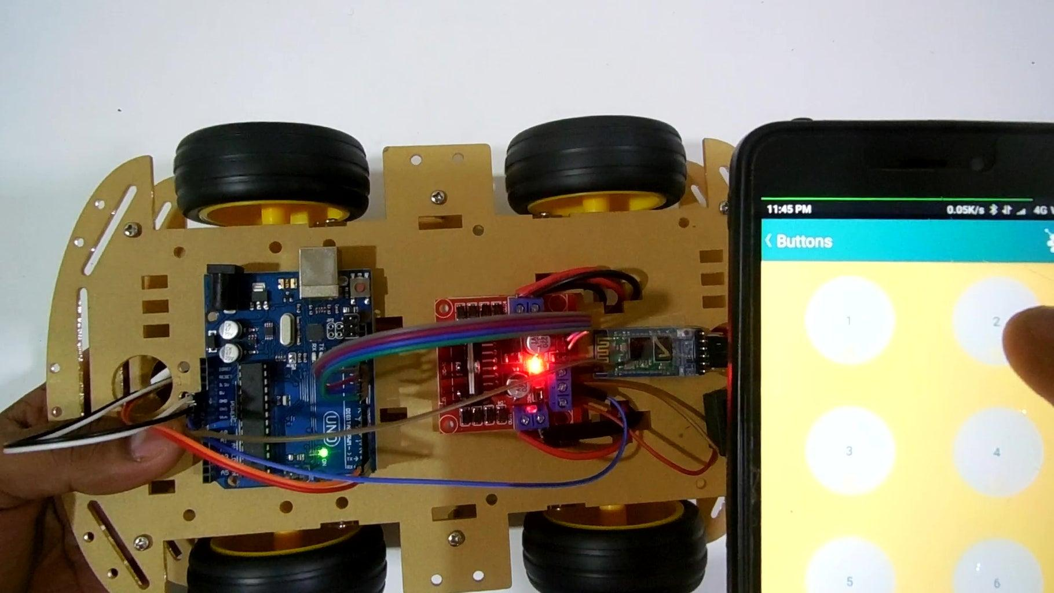
ANDROID CONTROL ROBOT CAR
We create a bluetooth Controlled robot car which is built using Microcontroller in which serial communication is done via Bluetooth and programming is done in embedded C language.

Slide 8
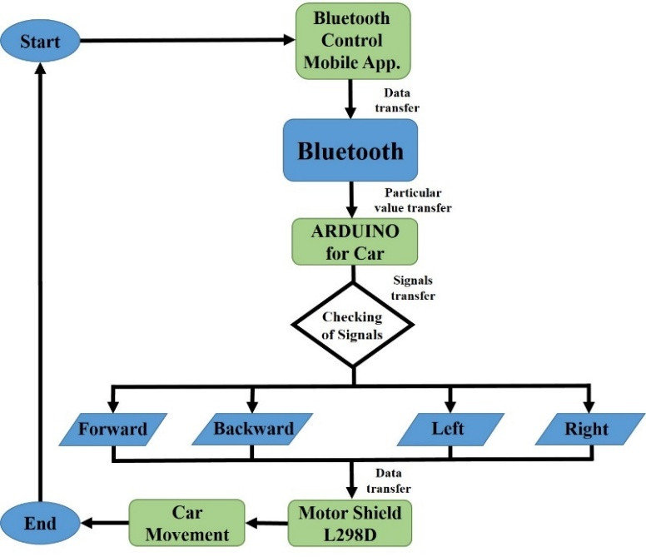
Block Diagram for robot car:

Slide 9
Component for robot car:
Arduino UNO
BLUETOOTH MODULE
MOTOR DRIVER L298N
4 wheels
4 Gear Motor
Battery
Jump wire
Plastic Board

Slide 10
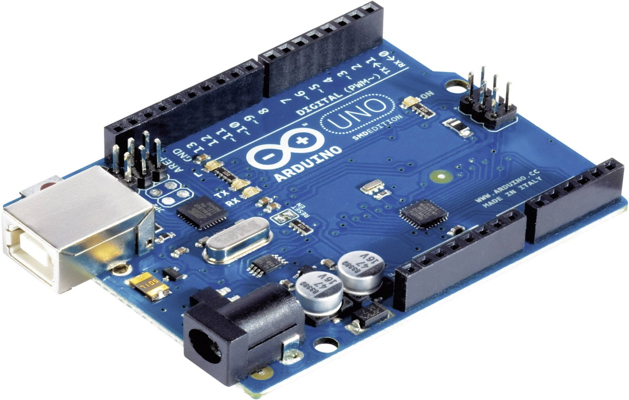
Arduino UNO
Microcontroller :
14 digit I/O pins which can also be
used for serial Communication.
On –Board regulated 5V Supply
Works with Motor Driver Shield

Slide 11
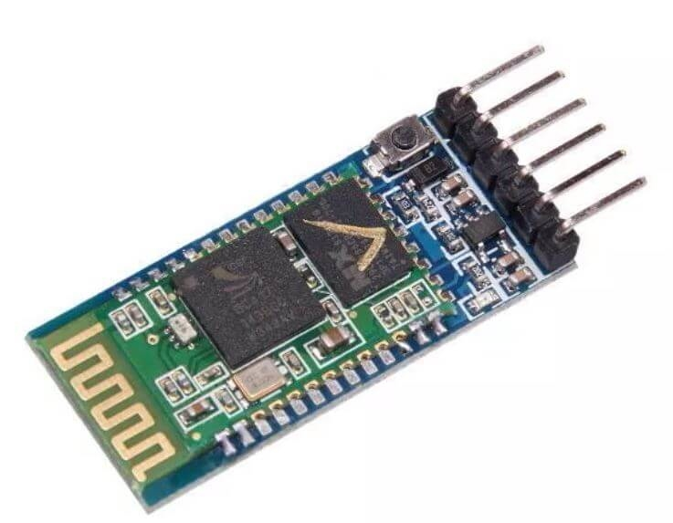
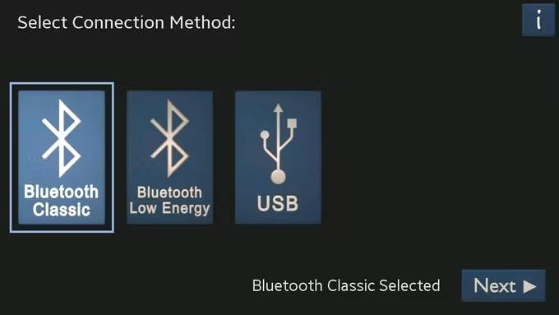
BLUETOOTH MODULE
The HC-05 small size Bluetooth TTL transceiver module are designed for serial communication (SPP-serial port profile). It allows our target device to both send or receive TTL data via Bluetooth technology without connecting a serial cable to your computer. It has coverage up to 30 ft / 10 m with built an Antena. It has power input: 3.3 V Dc

Slide 12
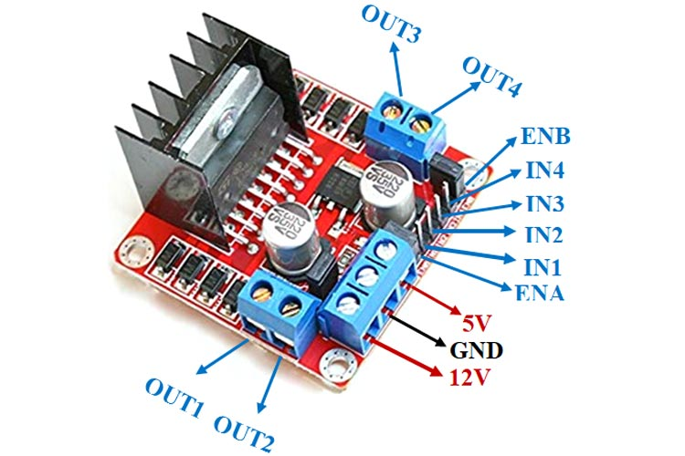
MOTOR DRIVER L298N
The L298N Motor Driver is a controller that uses an H-Bridge to easily control the direction and speed of up to 4 DC motors, or 2 DC motors . This tutorial will show you how to use it.

Slide 13
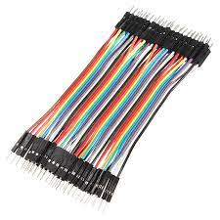
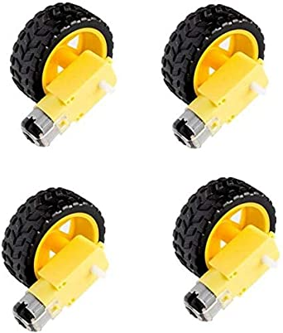
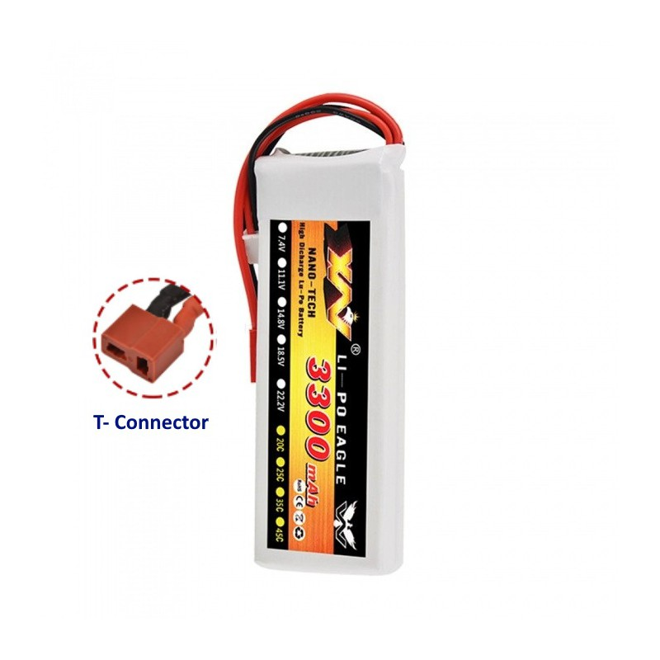
OTHER COMPONENTS
4 wheels
4 Gear Motor
Battery
Jump wire
Plastic Board

Slide 14
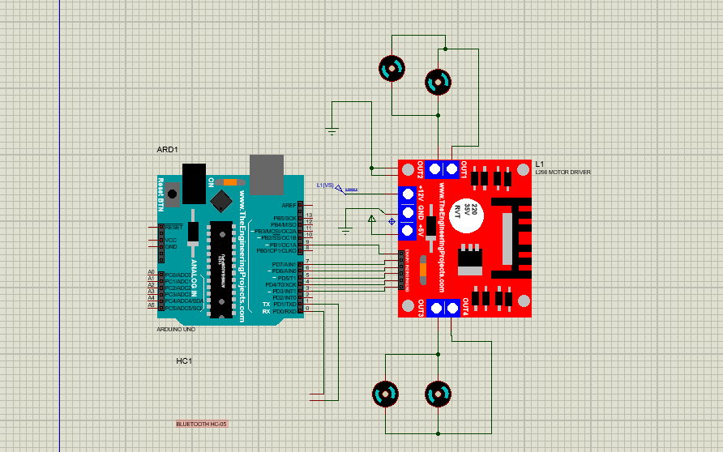
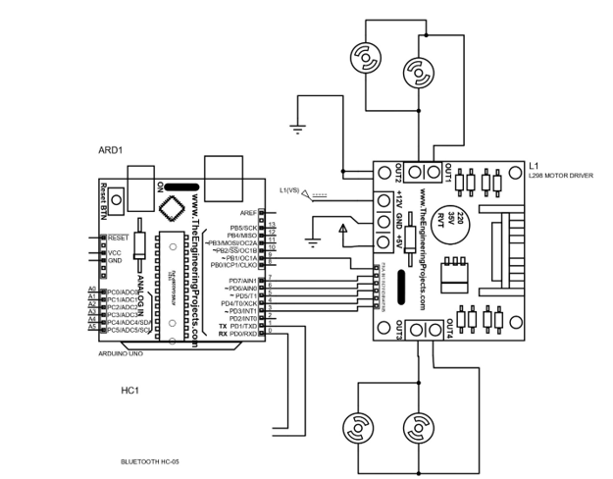
Proteus simulation :

Slide 15
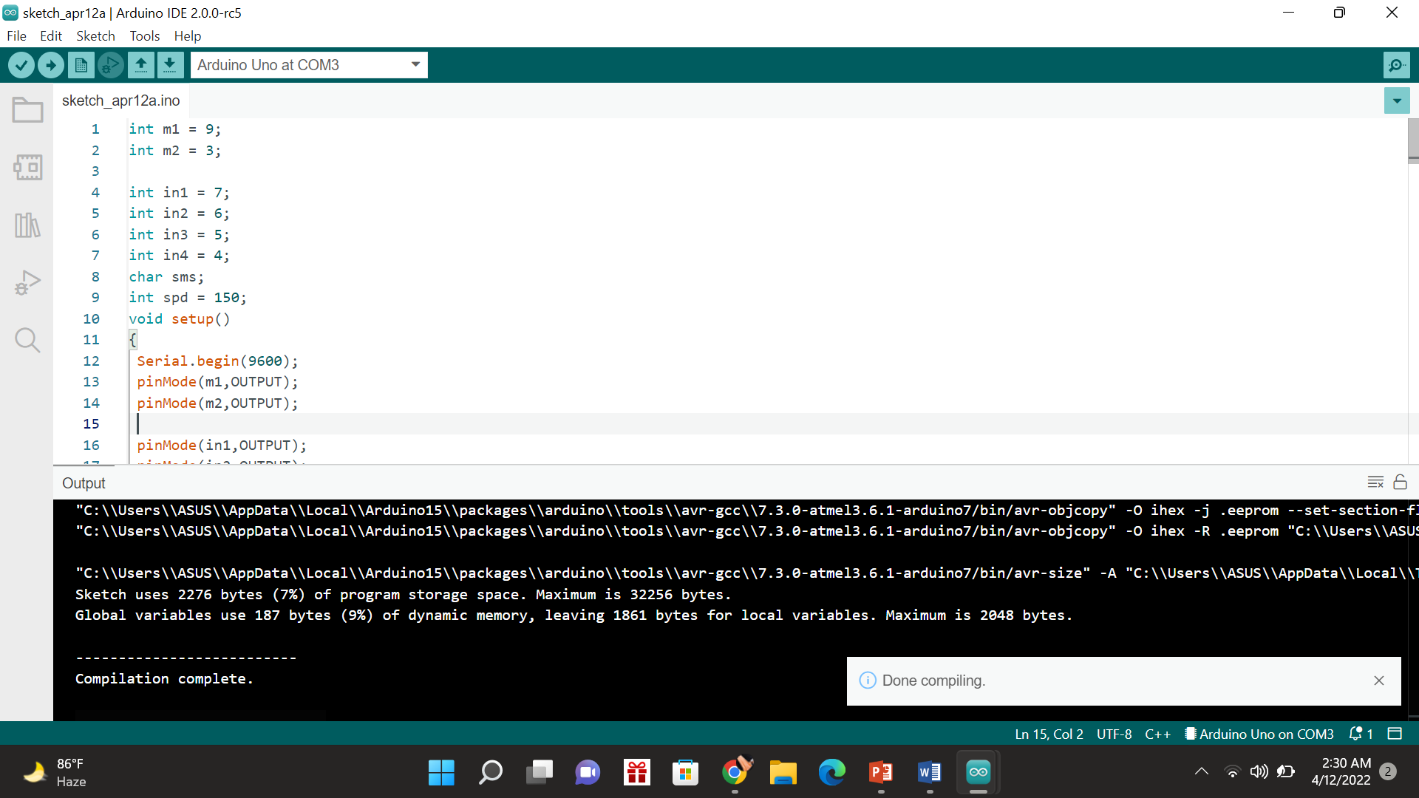
Coding :

Slide 16
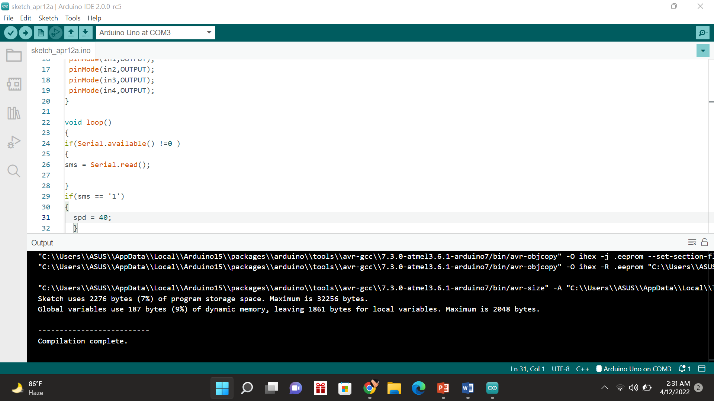
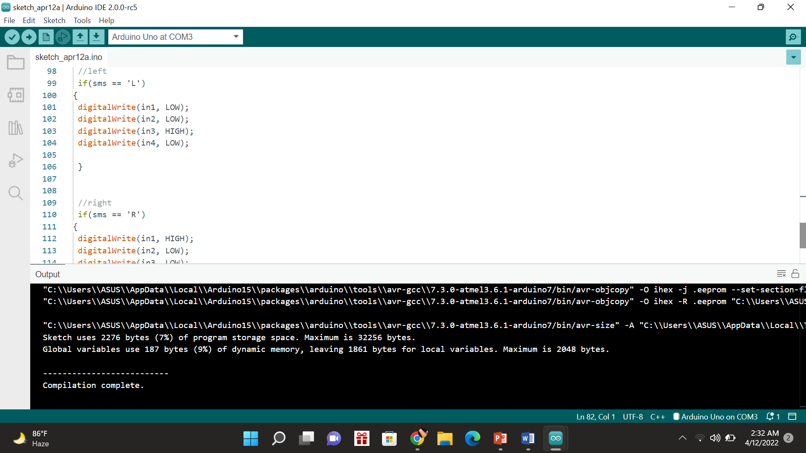
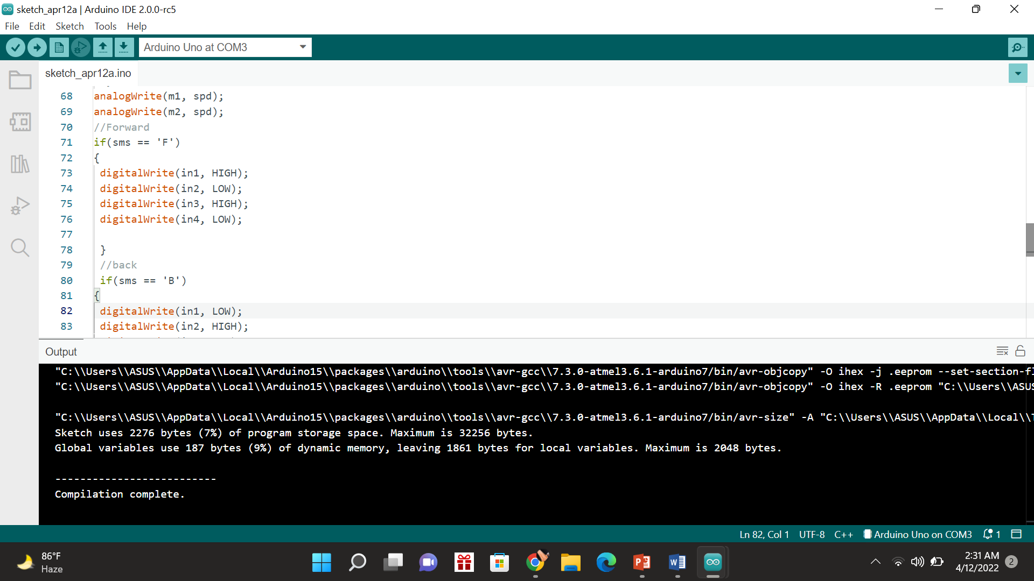
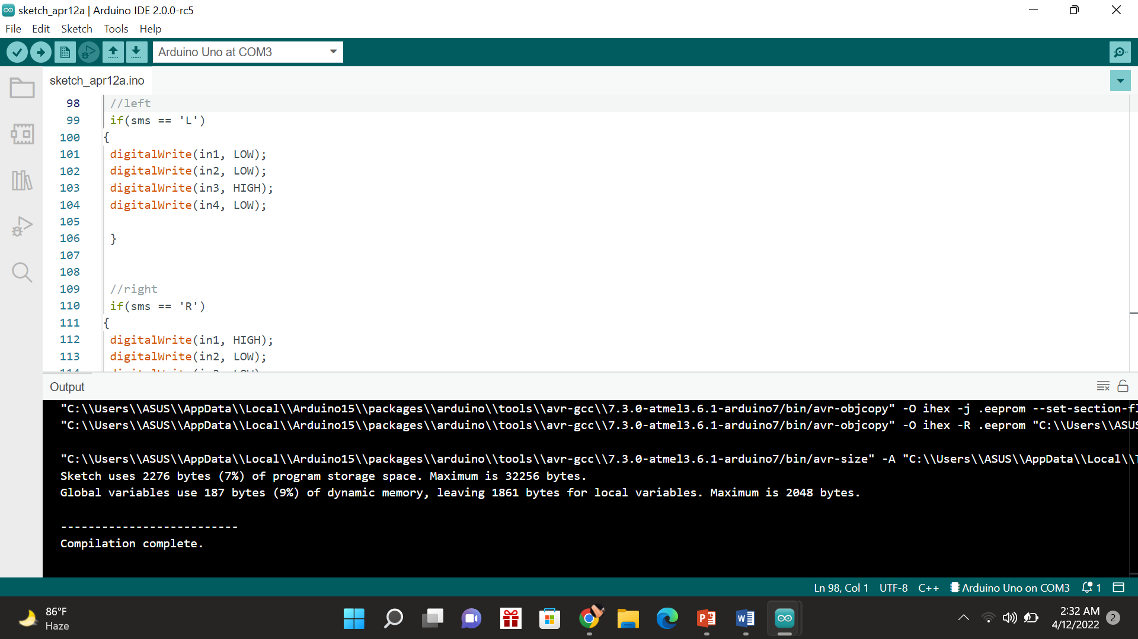

Slide 17
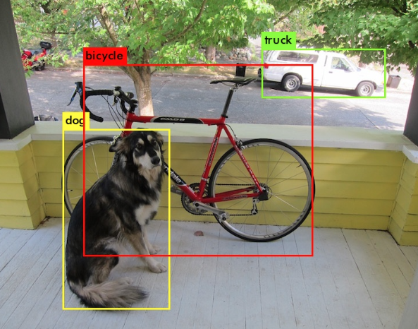
How do we want to solve the problem
Here, we propose a system that detects object using deep learning.
For the system, we will use the YOLO V7 detector, which is an object detection method. Since it is common for object detectors, the information learned by the convolutional layers is passed on to a classifier, which makes the detection prediction. In YOLO, the prediction is based on the convolutional layers.

Slide 18
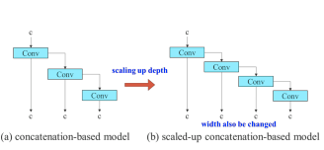
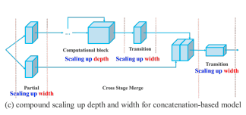
YOLO-V7(Model Architecture)
Figure: Model scaling for concatenation-based models. From (a) to (b), we observe that when depth scaling is performed on concatenation-based models, the output width of a computational block also increases. This phenomenon will cause the input width of the subsequent transmission layer to increase. Therefore, we propose (c), that is, when performing model scaling on concatenation based models, only the depth in a computational block needs to be scaled, and the remaining of transmission layer is performed with corresponding width scaling.

Slide 19
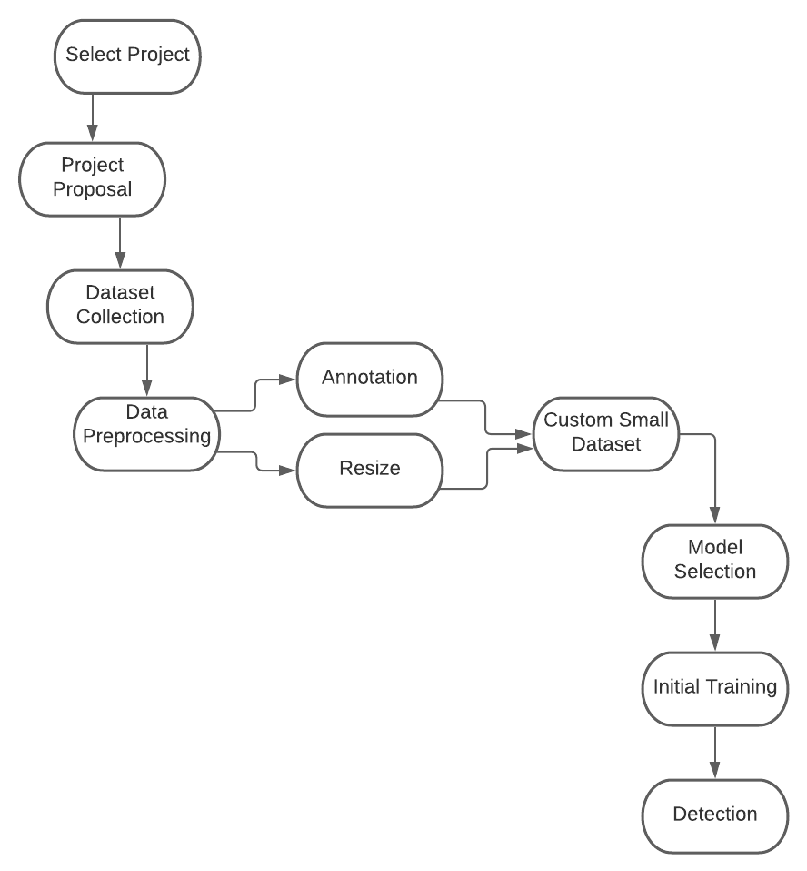
Diagram

Slide 20
Tools
Google Colab
Roboflow to annotate & resize our dataset
Python libraries(Numpy, Torch etc)
YOLO v7 model to detect object
Dataset: COCO(Common Object in Context)
“https://cocodataset.org/#download”
Challenge 2020

Slide 21
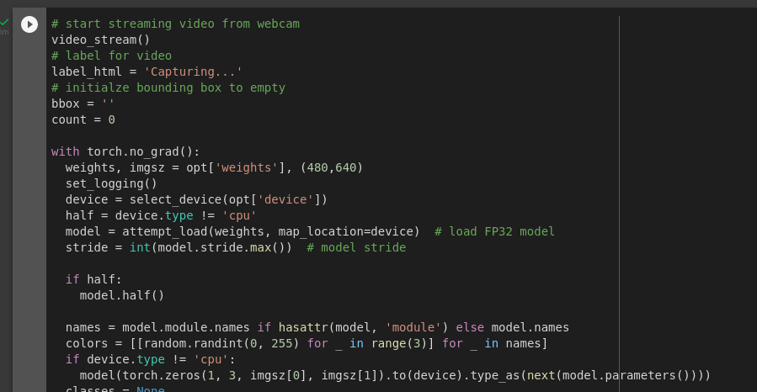
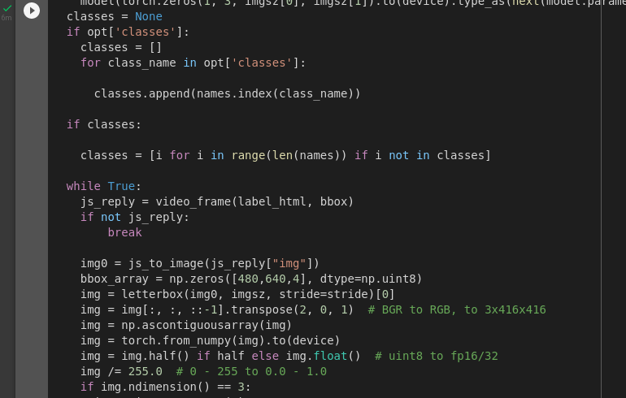
Coding

Slide 22
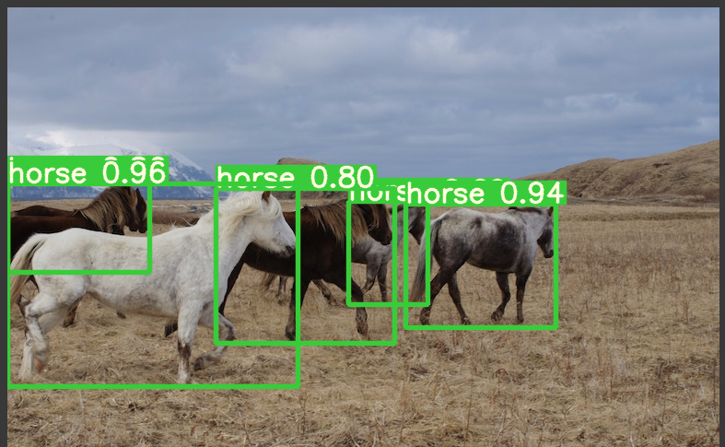
Output(Image-Input)

Slide 23
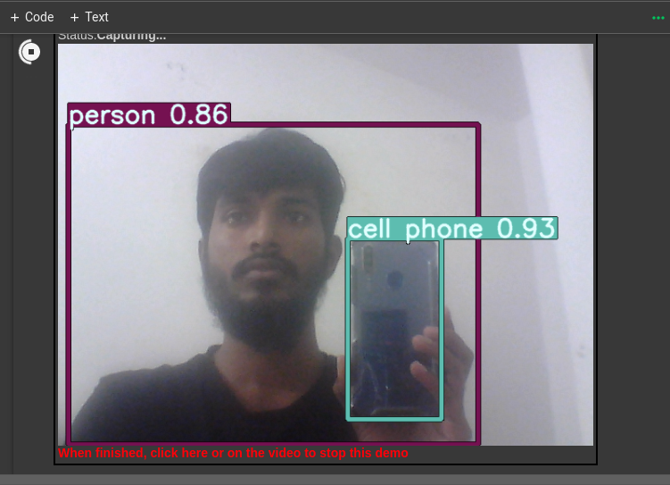
Output(Webcam-Input)

Slide 24
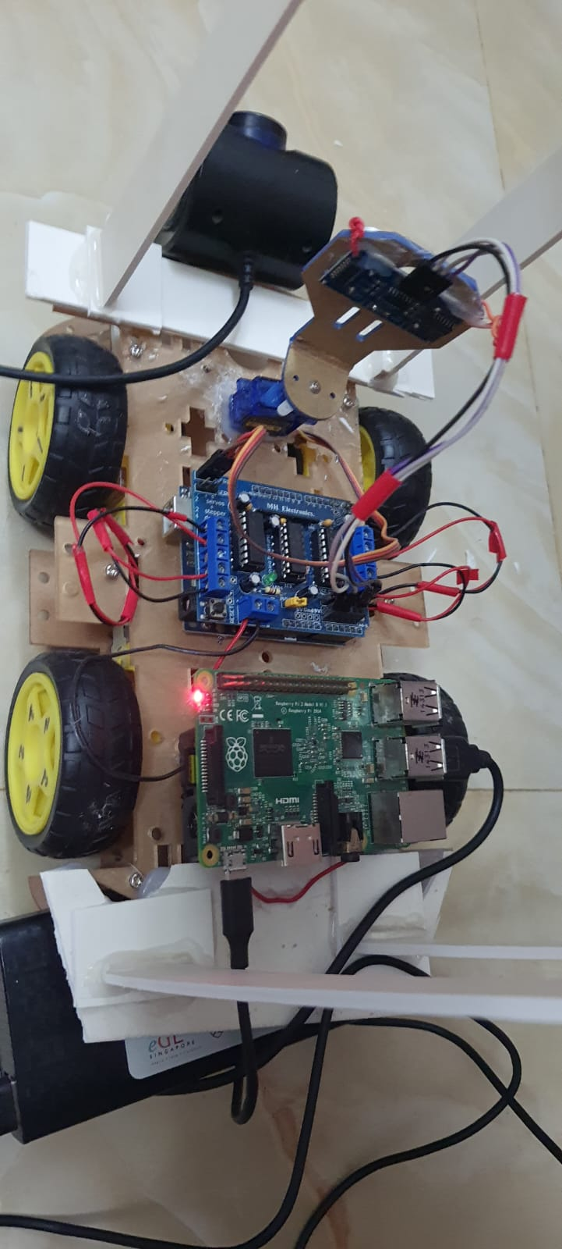
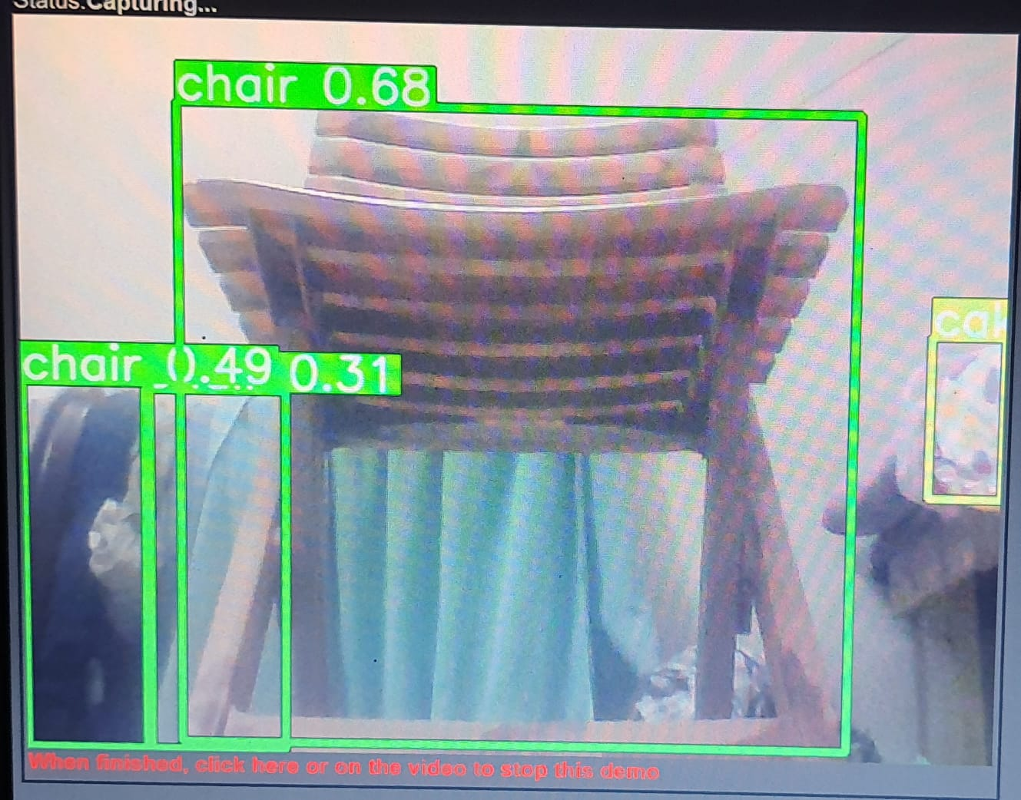
Integration with Raspberry Pi :

Slide 25
Total Cost
Name of Components | Quantity | Product Price(BDT)
Robot car chassis Kit | 1 | 1200
HC -05 Bluetooth Model | 1 | 345
Arduino Uno R3 | 1 | 1,100
L298 H-Bridge Dual Motor | 4 | 550
Soldering kit ,Board ,Wire | As per required | 1,175
Raspberry Pi | 1 | 2000
3300Mah lipo battery | 2 | 2000
Glue gun | 1 | 1000
Power Bank | 1 | 400
1080p camera | 1 | 500
Total |  | 10,270 BDT

Slide 26
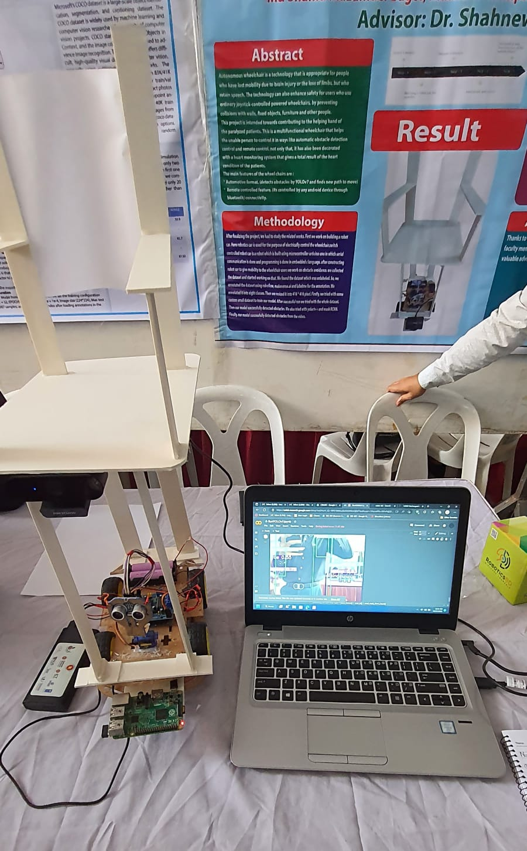
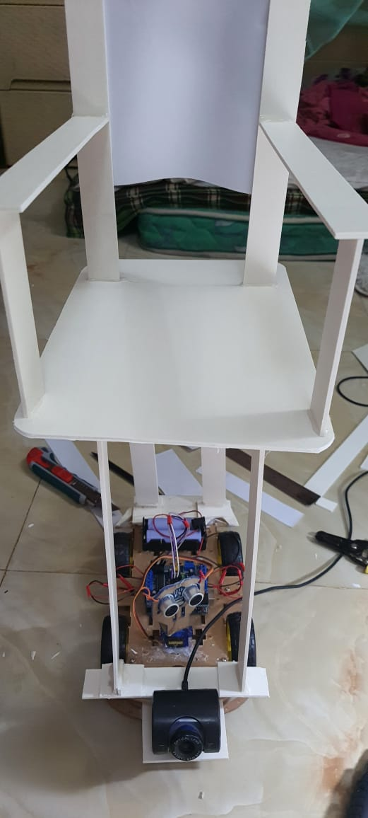
Demonstration (Image)

Slide 27
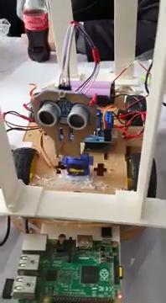
Demonstration (Video)

Slide 28
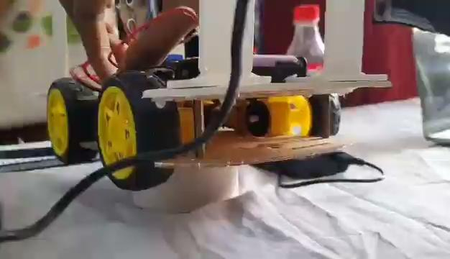

Slide 29
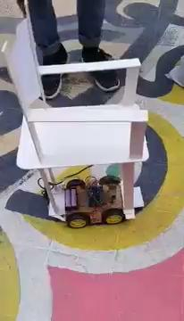

Slide 30
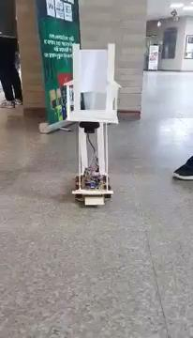

Slide 31
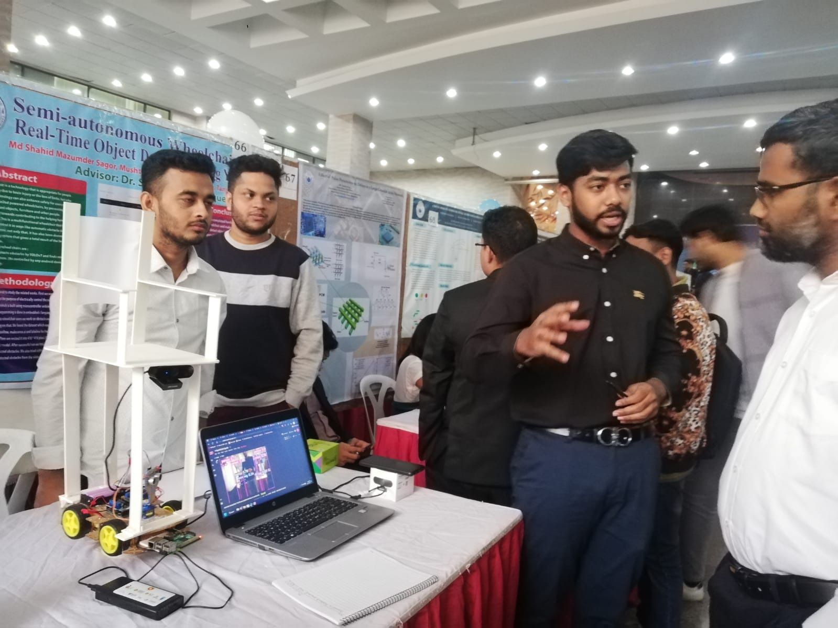
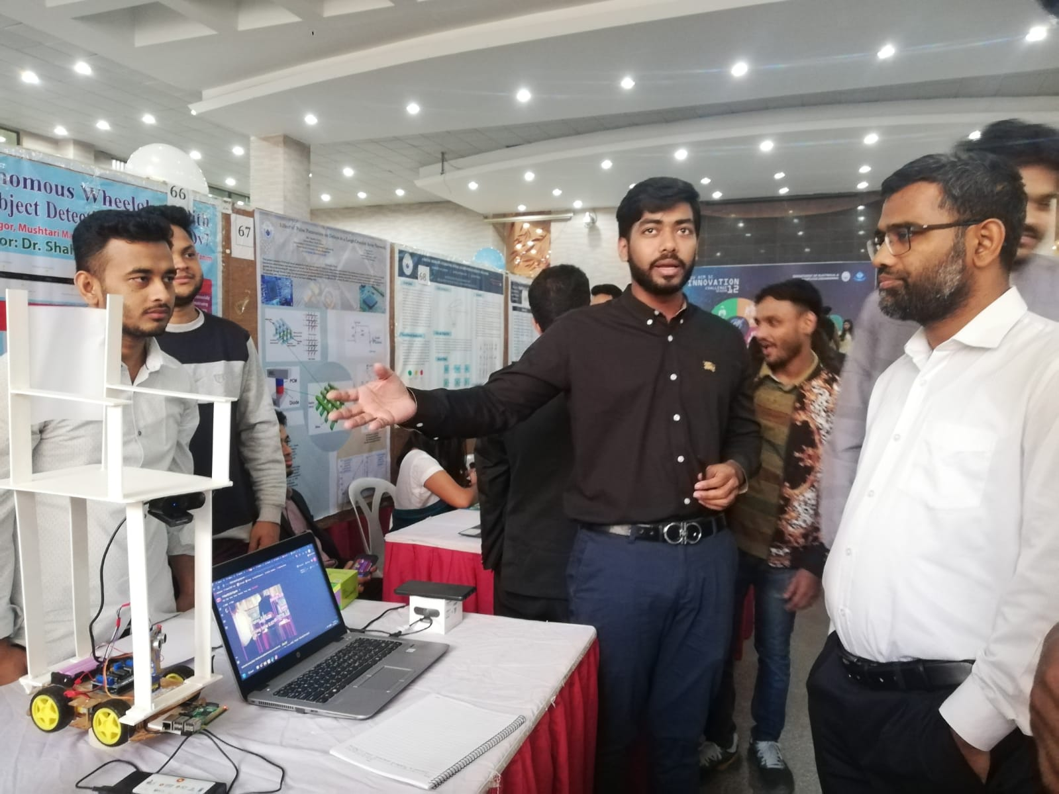
Presentation : Here are some glimpse from our project showcase. We were highly praised by our honorable faculties.

Slide 32
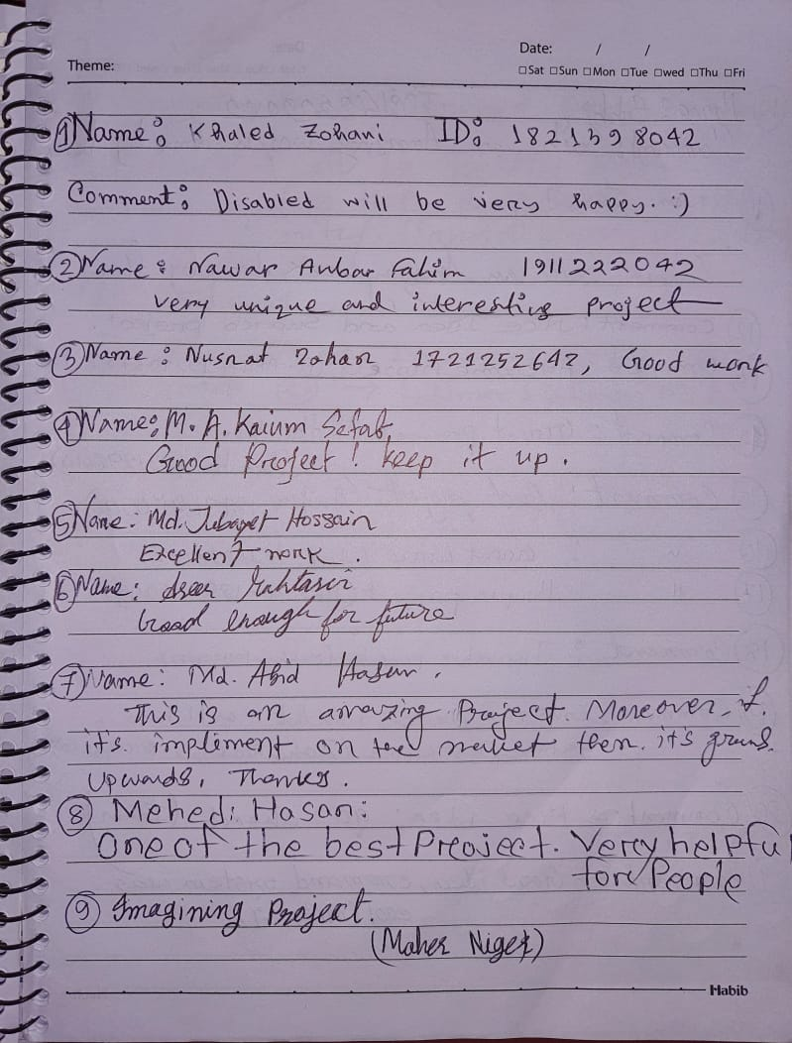
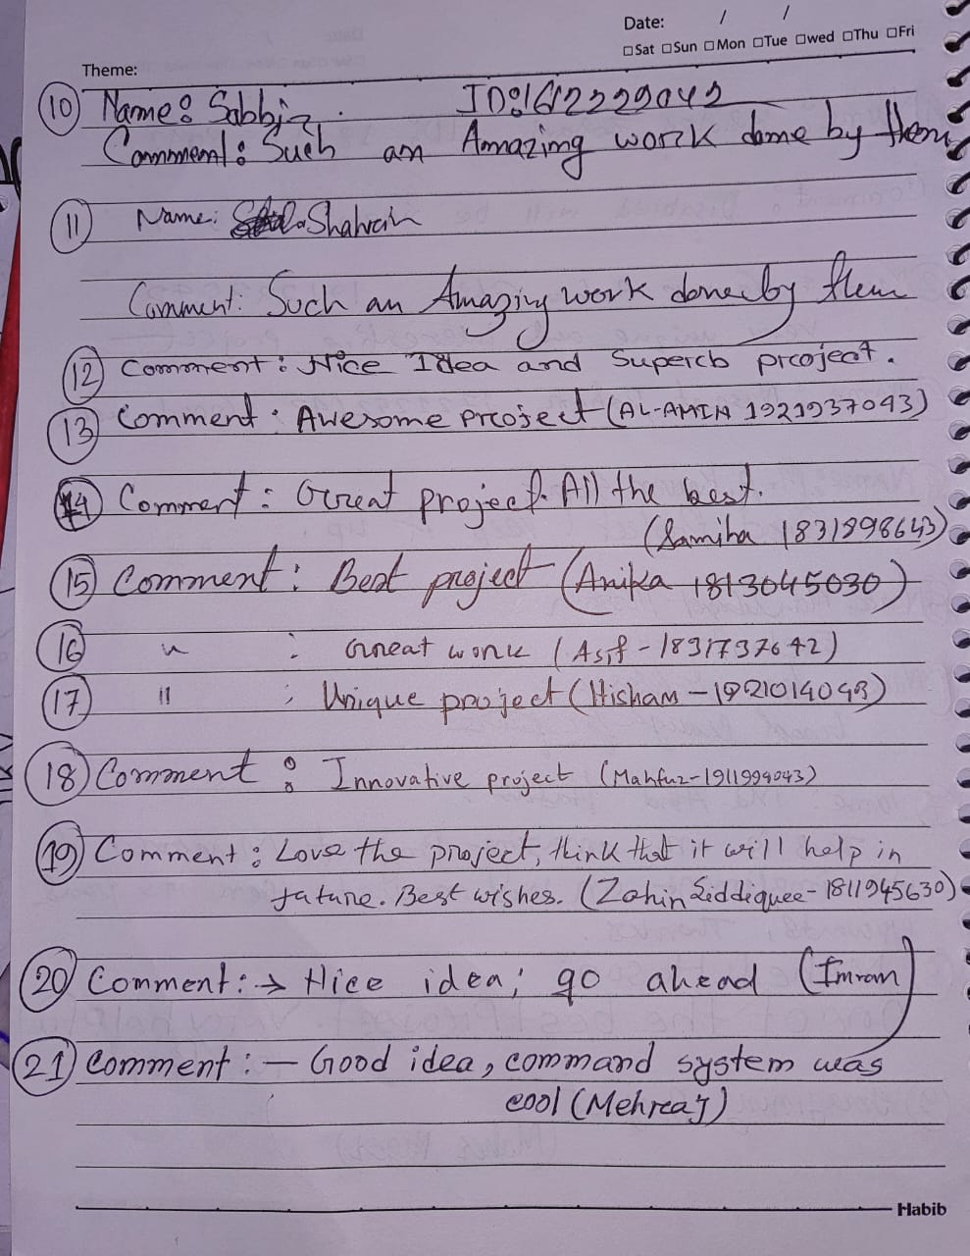
Comments : Here are some inspiring comments given to us by who have visited our stall during capstone project showcase.

Slide 33


